Slide 1
AI-DRIVEN VIDEO SUMMARIZATION USING LANGCHAIN AND LLM
A End-Term Project Presentation
On
Submitted by
Student Name : Samagra Gupta
Soham Kolhe
Reg. No. 229301588
229301587
Under the Guidance of
Dr. ……………….
Professor, Dept. of CSE

Slide 2
Table of Content:
Introduction
Literature review
Research Gaps
Problem Statement
Objectives
Methodology and Results
Conclusion
Future Scope
References
Outcome

Slide 3
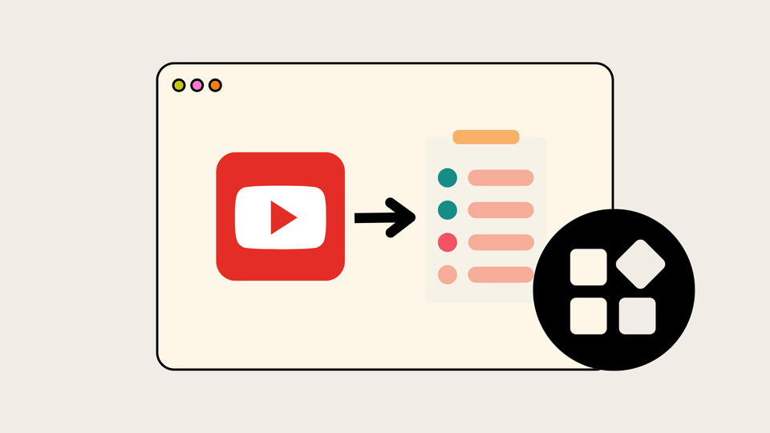
Introduction
The surge in online videos makes content discovery challenging. Video summarization helps by condensing videos while retaining key information. Traditional extractive methods struggle with contextual richness, making abstractive summarization more effective. This paper explores using LangChain, a framework for managing multiple LLMs, to improve abstractive video summarization. By leveraging LangChain, the aim is to generate concise, informative, and contextually accurate summaries, enhancing accessibility and efficiency in video content consumption.

Slide 4
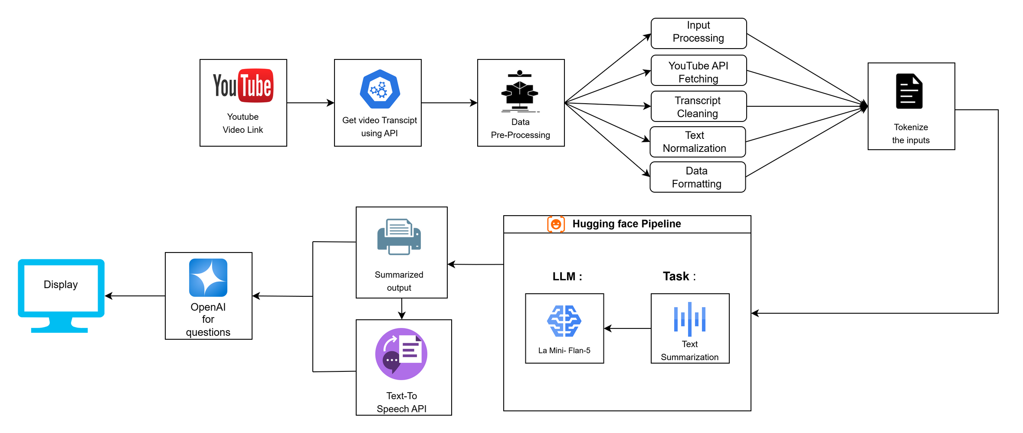
Problem Statement
Users face difficulties when trying to watch long online videos efficiently because of the fast-growing video content on the internet. Extractive summarization approaches tend to overlook both narrative elements and contextual information and emotional depth in their summaries. The research develops an AI-powered video summarization platform which combines LangChain and LaMini-Flan-T5 to produce superior abstractive summaries from video content. The system retrieves video transcripts before using transformer-based LLMs for processing and delivers an interface that enables users to query through natural language while playing back audio content.

Slide 5
Proposed Objectives:
Objective 1 :
By combining OpenAIs language model with an AI powered video summarizer ,through LangChain technology users can now ask questions, about the summarized video content seamlessly This new feature boosts the systems user friendliness by enabling natural language queries and offering responses derived from the extracted video summaries.
Objective 2:
To ensure the interface is user friendly and straightforward for users to navigate easily we will utilize Streamlit. This platform enables users to input video URLs access overviews. Listen to the content via the Text, to Speech API.
Objective 3:
The goal is to create an AI video summarization tool which uses LangChain and LaMini-Flan-T5 hybrid architecture to produce abstractive summaries that stay aware of context. The system will process video transcripts, keep semantic coherence and emotional depth, and offer a user-friendly interface with natural language querying and audio playback so users can easily understand the key points of long videos.

Slide 6
Objective 1 Methodology and Results :
Transcript Extraction
Extract video transcripts using APIs (e.g., YouTube Data API)
Hybrid Summarization Model
Combine LangChain (for orchestration) with LaMini-Flan-T5 (for abstractive, context-rich summaries)
Natural Language Querying
Enable user Q&A via OpenAI’s LLM, extracting answers from summarized content
User Interface
Streamlit-based UI with video input, summary display, query box & TTS playback

Slide 7
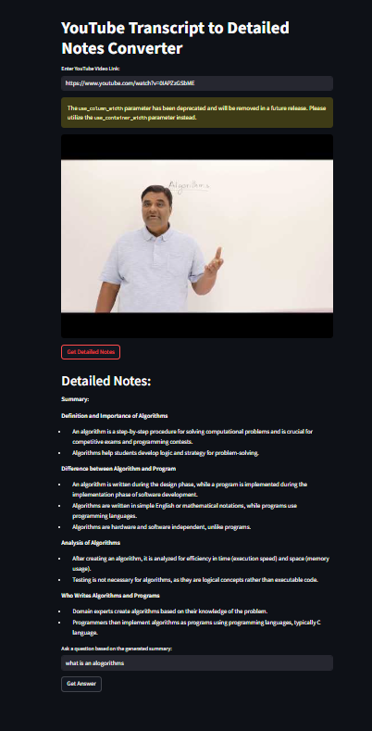
Results:
High-quality, coherent summaries
Accurate, context-aware query responses
Faster understanding of long videos
Seamless, user-friendly experience

Slide 8
Objective 2 Methodology and Results:
Streamlit Interface
User-friendly UI for easy navigation
Users input YouTube URLs to access content
Transcript Processing
Automatic extraction and cleaning of video transcripts
Hybrid Summarization Model
LangChain + LaMini-Flan-T5 for coherent, abstractive summaries
Natural Language Querying
Powered by OpenAI’s LLM for context-aware Q&A
Text-to-Speech (TTS)
Listen to summarized content via integrated TTS API

Slide 9
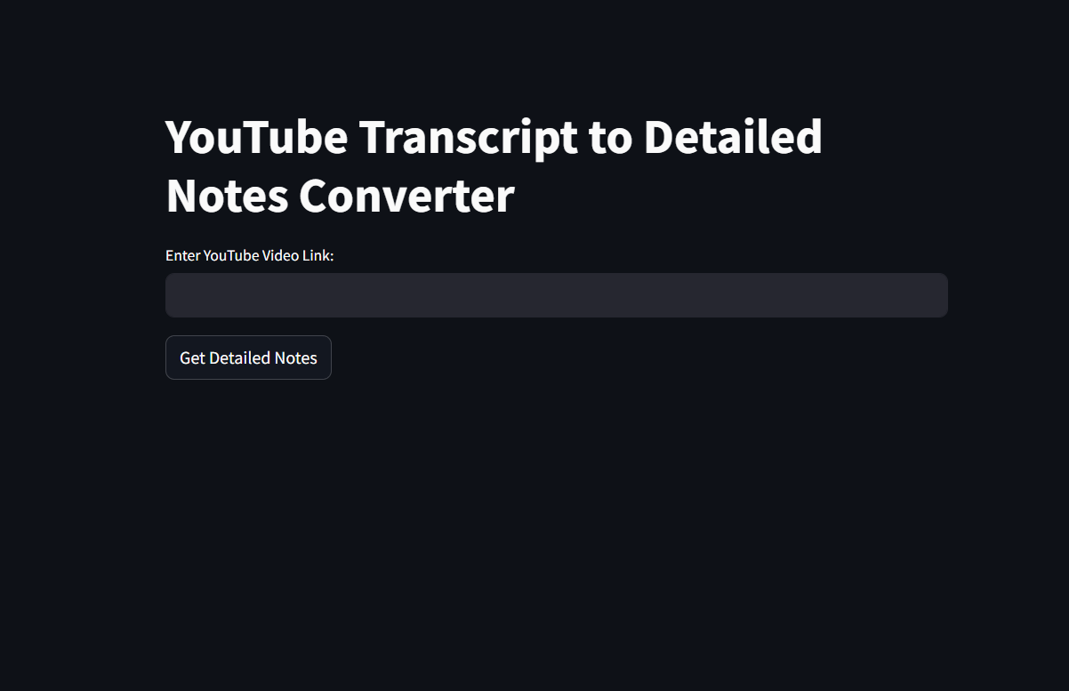
Results:
Clear, human-like summaries
Efficient information access through Q&A
Audio summaries for accessibility
Smooth user experience with Streamlit UI

Slide 10
Objective 3 : Methodology and Results
Transcript Extraction & Processing
Extract and clean transcripts from video URLs (e.g., YouTube)
Hybrid Summarization
Use LangChain for workflow orchestration
Apply LaMini-Flan-T5 to generate coherent, emotionally rich summaries
Natural Language Querying
Integrate OpenAI's LLM to answer user queries based on the summarized content
User Interface
Build a simple, interactive UI withStreamlit
Enable Text-to-Speech playback for audio summaries

Slide 11
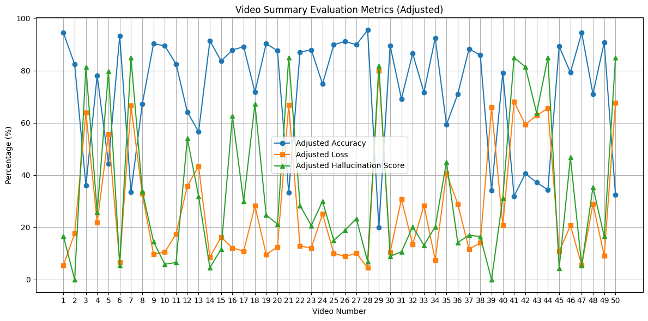
Results:
Abstractive summaries with strong semantic and emotional continuity
Accurate, natural language responses to user queries
Faster understanding of long videos
Accessible, smooth user experience with visual + audio outputs

Slide 12
Conclusion
AI-driven video summarization significantly enhances content accessibility and efficiency.
Integration of LangChain and LaMini provides an effective summarization pipeline with improved user interaction.
Challenges such as computational costs and context truncation require continuous optimization and fine-tuning.
Future advancements will focus on real-time summarization, multimodal learning, and improved scalability

Slide 13
Future Work
Multimodal Learning: Combine video, audio, and text for deeper contextual understanding.
Domain-Specific Fine-Tuning: Train AI models for different content types to improve relevance.
Real-Time Summarization: Utilize edge computing and distributed AI for low-latency, live video summarization.

Slide 14
REFERENCES
[1] B. Bineesh and S. Shunmugan, “Comparative work on video summarization methods,” J. Inf. Comput. Sci., vol. 10, no. 6, pp. 1548–7741,2020.
[2] A. Senthilselvi, R. Prawin, V. Harshit, et al., “Abstractive summarization of youtube videos using lamini-flan-t5 llm,” in 2024 Second International Conference on Advances in Information Technology (ICAIT), vol. 1, pp. 1–5, IEEE, 2024.
[3] A. Ramakrishnan and C.-K. Ngan, “A hybrid video-to-text summarization framework and algorithm on cascading advanced extractive-and abstractive-based approaches for supporting viewers’ video navigation and understanding,” in 2022 IEEE Fifth International Conference onArtificial Intelligence and Knowledge Engineering (AIKE), pp. 36–39,IEEE, 2022.
[4] M. Gygli, H. Grabner, and L. Van Gool, “Video summarization by learning submodular mixtures of objectives,” in Proceedings of the IEEE conference on computer vision and pattern recognition, pp. 3090–3098,2015.
[5] M. Kini and K. Pai, “A survey on video summarization techniques ,”in 2019 Innovations in Power and Advanced Computing Technologies(i-PACT), vol. 1, pp. 1–5, IEEE, 2019.
[6] M. Wu, A. Waheed, C. Zhang, M. Abdul-Mageed, and A. F. Aji,Lamini-lm: A diverse herd of distilled models from large-scale instructions,”arXiv preprint arXiv:2304.14402, 2023.

Slide 15
OUTCOME
Current Status of ( research paper ) : Accepted & Submitted
Current Status of Deployement : (Fully Deployed and 100% completed)
Provide associated details : ……………………………………….

